Slide 1
Angular Installation
Anju Munoth

Slide 2
A brief History
Three major Angular versions have been released – Angular v1.x (a.k.a AngularJS), Angular 2 and Angular 4 (also known as Angular).
AngularJS has had a few major releases of its own with v1.1, v1.2 and so on, but will stick with v1.x for all purposes of discussion.
Angular v1.x and v2 are quite different in terms of architecture.
While Angular v1.x was based on an MVC architecture, Angular 2 is based on a component/services architecture.
Considering Angular was moving from MV* (Model View Whatever) pattern to components focused approach, the framework features were very different from each other and caused many application developers to rewrite a major portion of their code base.
However, Angular v2 to v4 is a very different story. It is a rather progressive enhancement. A majority of changes are non-breaking.
Angular 4 was released on 23rd March ’17 and the latest version being Angular 15

Slide 3
Angular uses SEMVER (Semantic Versioning)
Angular v2 was released in September 2016
At the same time the angular team announced that they are going to switch to SEMVER i.e. Semantic Versioning.
In Semantic versioning, the type of release is classified into major, minor, or patch release and based on the nature of the software release, the software version will get bumped up accordingly

Slide 4
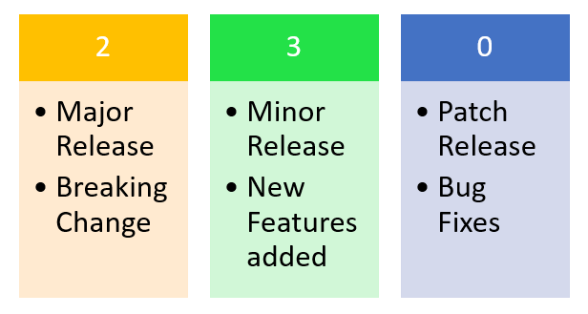
A semantic version consists of the following three numbers which has the meaning attached to them.
SEMVER (Semantic Versioning)
A semantic version consists of the following three numbers which has the meaning attached to them

Slide 5
What happened to Angular v3?
Angular 2 has been a single repository, with individual packages downloadable through npm with the @angular/package-name convention. For example @angular/core, @angular/http, @angular/router so on.
Considering this approach, it was important to have a consistent version numbering among various packages.
The ‘router’ package module has the different version than the ‘core’ package modules. Due to this misalignment of the ‘router’ package module version, the angular team decided to jump to the Angular v4
Hence, the Angular team skipped a major version 3. It was to keep up the framework with Angular Router’s version.
Doing so will help avoid confusions with certain parts of the framework on version 4, while the others on version 3.

Slide 6
Angular 4 Enhancements
Angular 4 release has considerable improvements in bundle size. Some have reported up to 60% reduction in Angular bundles’ file size
ngc, AOT compiler for Angular and TypeScript is much faster
Angular 4 is compatible with TypeScript’s newer versions 2.1 and 2.2. TypeScript release helps with better type checking and enhanced IDE features .Changes helped the IDE detect missing imports, removing unused declarations, unintentionally missing “this” operator etc.
Template changes to ng-template
TypeScript’s Strict Null Check options is around the corner
Angular *ngIf/then/else - With Angular 4, support for else has been added
Angular Animations - In Angular 2.x, animations were part of @angular/core. It was part of the bundle even if the application never used animations. With Angular 4, animations related artifacts have been moved out of @angular/core. It helps reduce production bundle size.

Slide 7
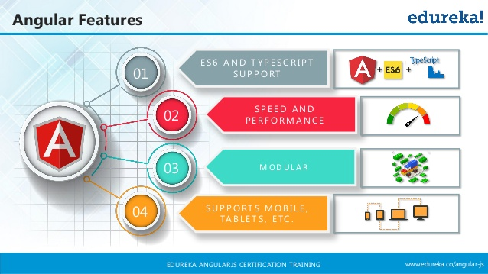


Slide 8


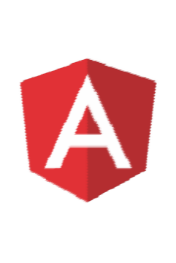
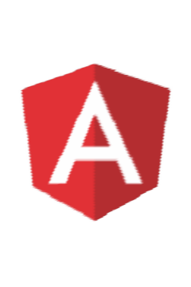

Cross Platform
Features of Angular
Speed and Performance
Productivity
Development

Slide 9

Cross Platform
Angular use modern web platform capabilities to deliver app-like experiences.
High performance and zero-step installation.
Build native mobile apps with Ionic Framework, NativeScript, and React Native.
Create desktop - installed apps across Mac, Windows, and Linux.

Slide 10

Speed and Performance
Angular turns our templates into code that's highly optimized for today's JavaScript
machines.
Serve the first view of your application on node.js, .NET, PHP, and other servers for rendering in just HTML and CSS. .
Angular apps load quickly with the new Component Router.

Slide 11

Productivity
Quickly create UI views with simple and powerful template syntax.
Command line tools:
Start building fast
Add components and tests
Then instantly deploy.
Get intelligent code completion, instant errors in popular editors and IDEs.

Slide 12

Full Development Story
Karma for unit tests.
Protractor makes our scenario tests run faster and in a stable manner.
Create high-performance, complex choreographies and animation timelines with very little code through Angular's intuitive API.

Slide 13

Speed & Performance,
Smaller application,
Modular application,
Cross-platform Web, Mobile & Desktop,
SPA,
RESTful API,
Uses TypeScript,
Rxjs API Integration,
& It has a huge community on GitHub.

Slide 14

TypeScript ?
Free & Open-Source programming language,
Developed & maintained by Microsoft, A superset of JavaScript,
Full Object-Oriented Programming with features like classes, interfaces & modules…
Support for ECMAScript 5 and uses arrow function syntax,
Compiles to plain JavaScript.

Slide 15
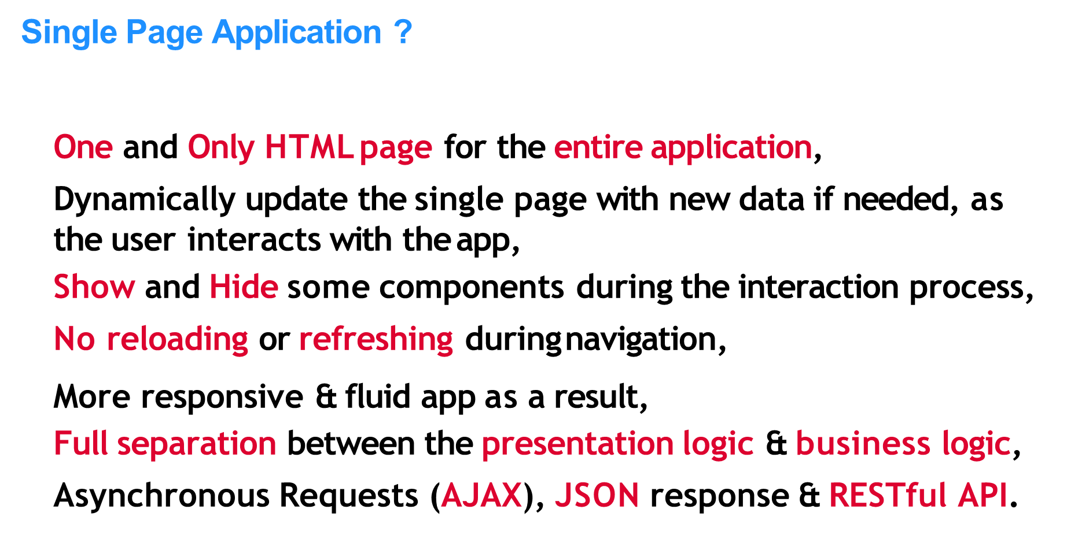

Slide 16
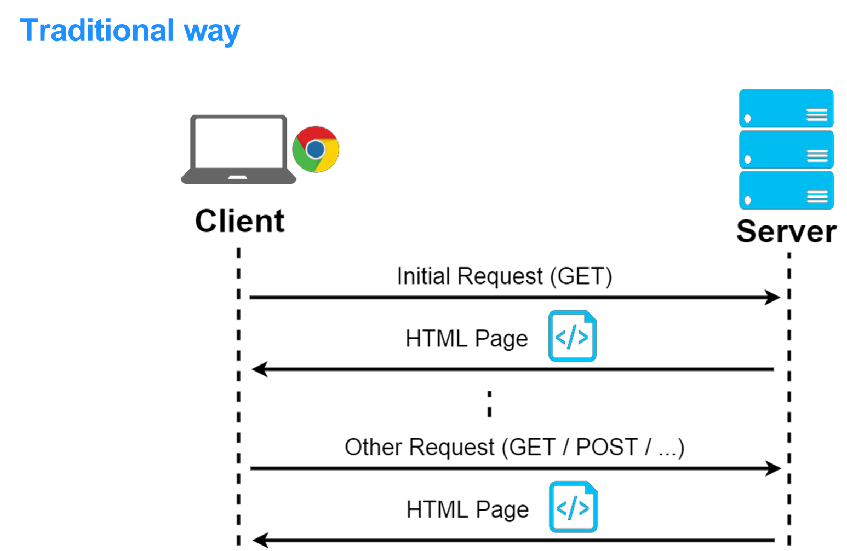

Slide 17
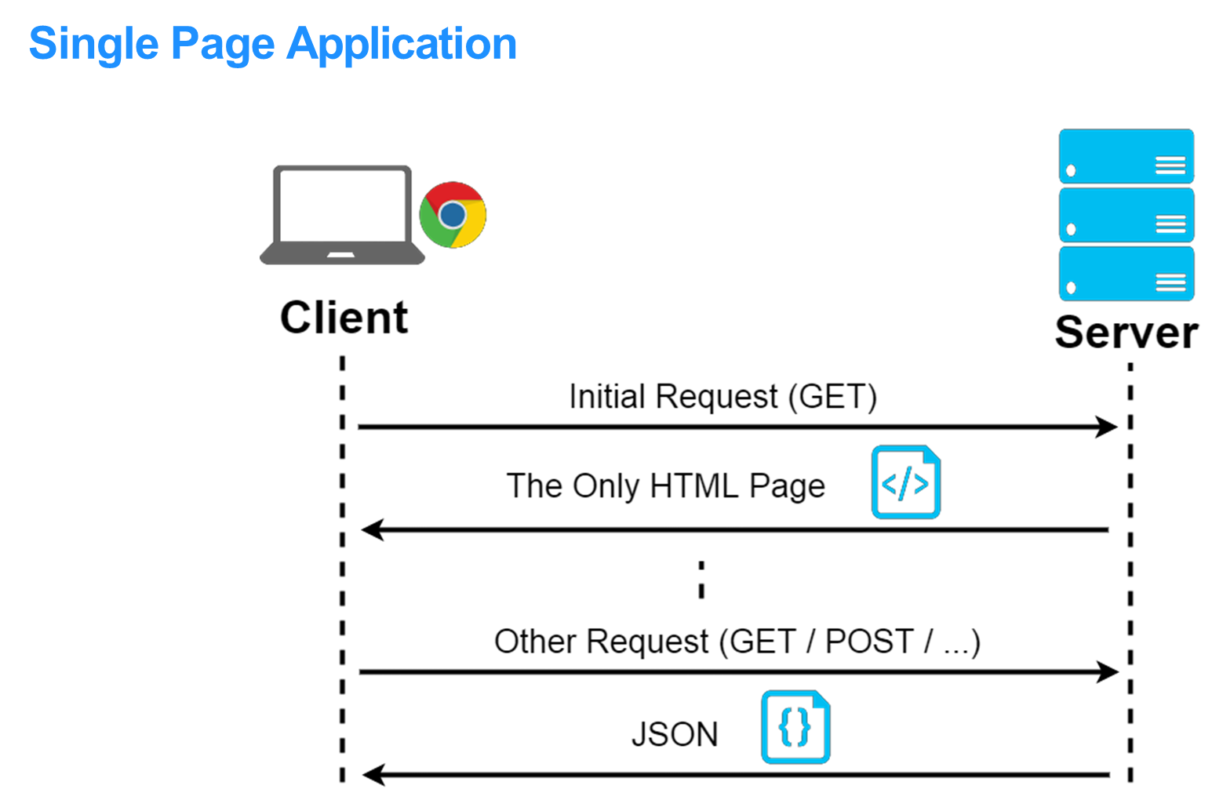

Slide 18
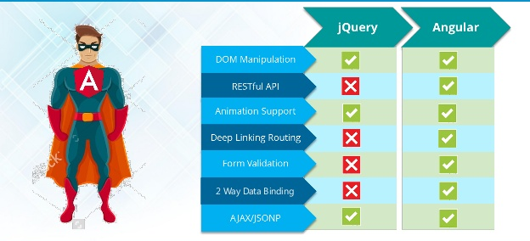

Slide 19
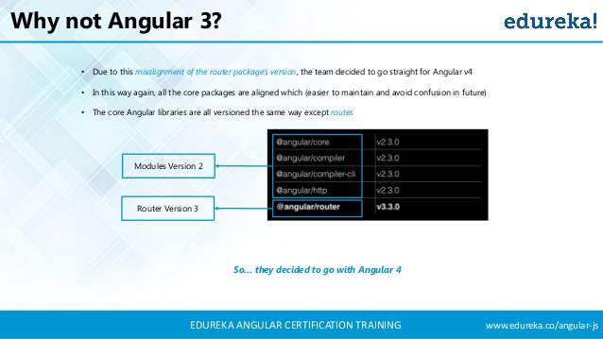


Slide 20
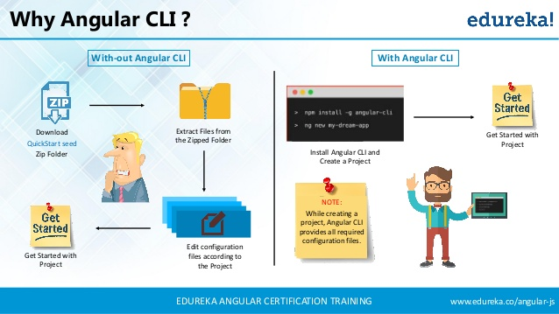


Slide 21
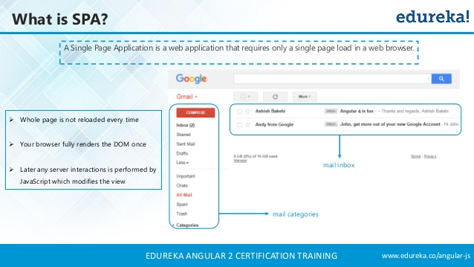

Slide 22
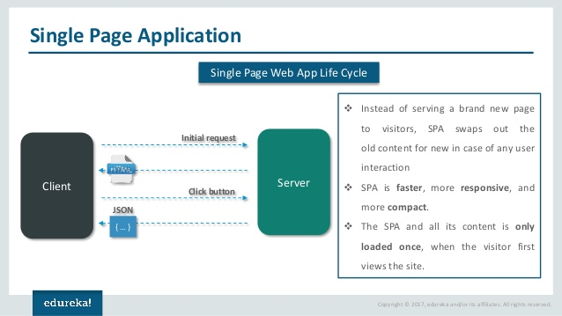

Slide 23
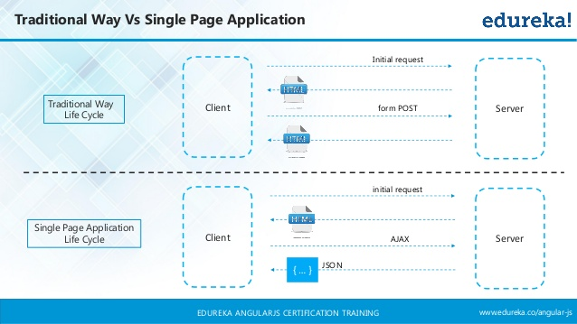

Slide 24
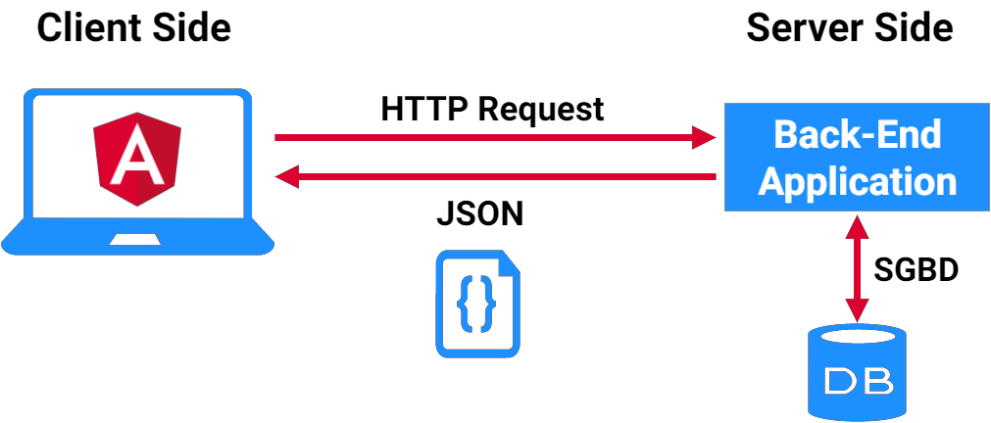
ANGULAR for Client Web App

Slide 25
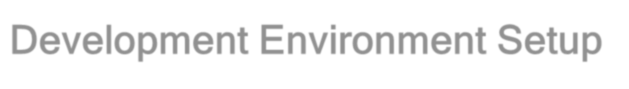

Development Environment Setup
Node.js
https://nodejs.org/en/download/
Node.js is an open-source, cross-platform JavaScript run-time environment for executing JavaScript code server-side.
Download latest version
Check node.js version
Syntax : - node -v
This command is used for checking current installed version of node.

Slide 26
Check npm version
Syntax : - npm -v
This command is used for checking current installed version of Node Package Manager (npm).
Text Editor
Visual Studio Code, WebStrome , Sublime or any other text editor IDE

Slide 27

Development Environment Setup
To develop the application using TypeScript we need to install the TypeScript package using the command,
Angular CLI (Command Line Interface) is a tool that allows us to create a project, generate it’s parts, build it and run it on the development server directly through the command line,

Slide 28
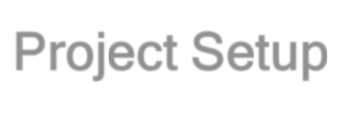


Project Setup
Install Angular CLI
Angular CLI is command line interface for Angular
Open node js command prompt in admin mode.
Syntax : - npm install –g <packagename>
F:/Angular4> npm install –g @angular/cli
Node.js command prompt
Current working directory
Package Name
Globally

Slide 29


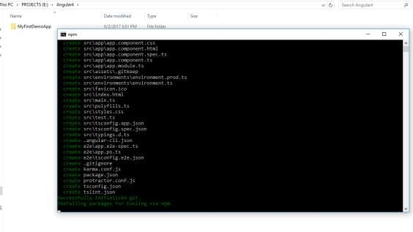
Step 2
Creating project using Angular CLI
Syntax : - ng new <project_name>
F:/Angular4> ng new MyFirstDemoApp
Node.js command prompt
Current working directory
Project Name

Slide 30

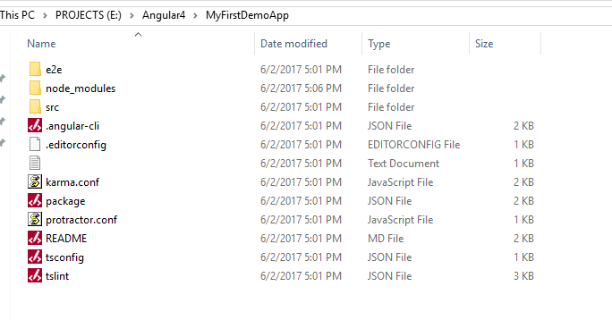


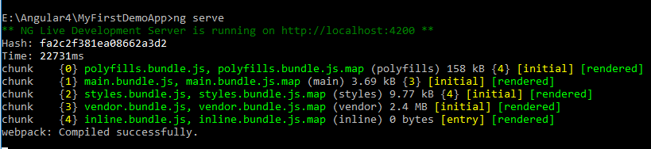
Step 3
Enter into newly created project folder i.e. MyFirstDemoApp
Step 4
Run application
ng serve command is used for to run application.
Syntax : - ng serve
F:/Angular4/MyFirstDemoApp> ng serve

Slide 31
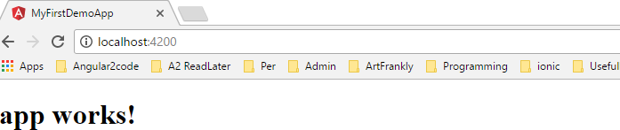
Step 5
Open web browser - localhost:4200

Slide 32
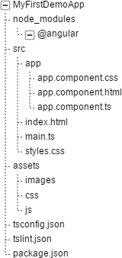
Structure of project
NPM is the node package manager, which installs packages locally into a project, specifically, into the node_modules folder.
Root project folder, all components reside is app folder.
Entry point of application
All images, stylesheets, JavaScript or third party libraries reside in assets
Configuration Files

Slide 33
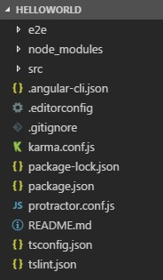
Basic Structure of ANGULAR Application
.angular-cli.json , package.json and tsconfig.json are the responsible files on the project configuration, it’s dependency management and it’s external packages.

Slide 34
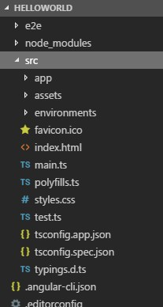
Basic Structure of ANGULAR Application
main.ts and index.html are the entry point to the application,
Since we are developing a SPA index.html is the only HTML page in the whole project,
style.css is the style sheet for the global app design.

Slide 35
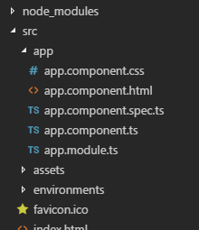
Basic Structure of ANGULAR Application
node_modules folder contains the packages installed by the npm tool,
app folder contains all the work, components, modules…

Slide 36

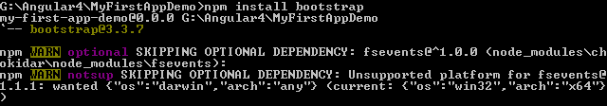
Installing Packages
npm install command is used for installing packages.
Syntax
npm install <package_name>
Example
F:/Angular4/MyFirstDemoApp> npm install bootsrap

Slide 37

How App Start
main.ts
Main.ts file is entry point of our application.
Main.ts file bootstrap app.module.ts file
app.module.ts
This file bootstrap our first component i.e app.component.ts
app.component.ts
This file render app.component.html file.
app.component.html
Final HTML template

Slide 38
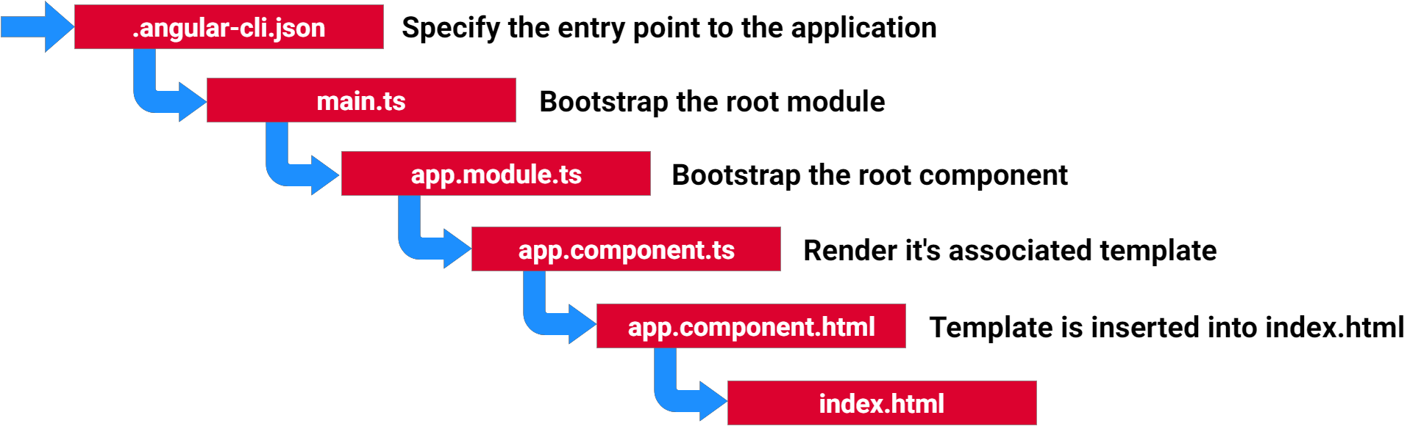
Bootstrapping the app

Slide 39
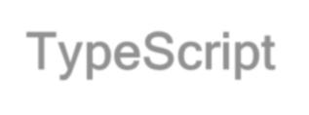
TypeScript
TypeScript is a free and open source programming language.
It is developed and maintained by Microsoft.
It is syntactical superset of JavaScript and adds optional static typings and class based object oriented programming to the language.

Slide 40
Building Blocks

Slide 41
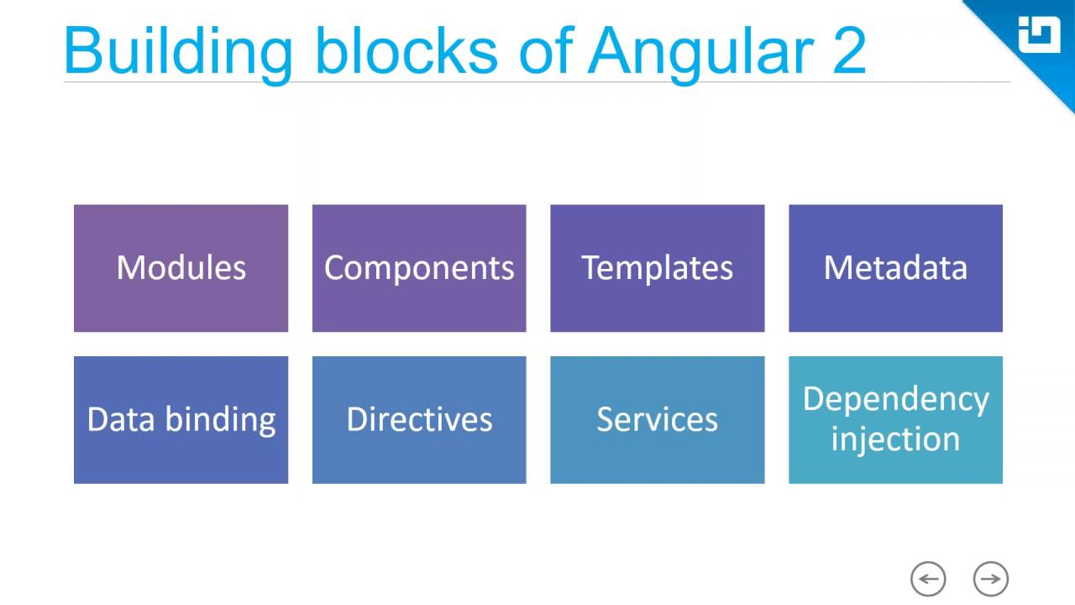

Slide 42
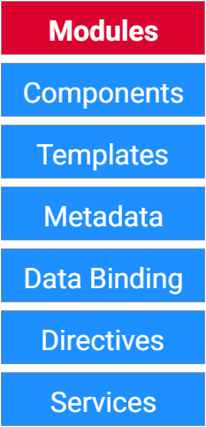
Building Blocks
Every Angular app has at least one Module, the
root module named AppModule,
An Angular app is a Modular app,
A module is a TypeScript class with the Decorator
@NgModule,
Each module in the application has it’s own Components, Directives, Services… They should be declared in @NgModule decorator,
Modules can cooperate to achieve some app functionalities.

Slide 43
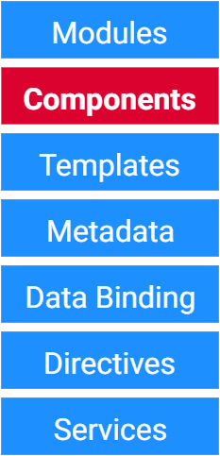
Building Blocks
A Component controls a piece of screen called
view,
This view is defined by the Template associated to the Component,
A Component handles the user interaction with the view (Template), passes data and properties to the view and updates it dynamically,
A Component is a TypeScript class with the Decorator @Component.

Slide 44
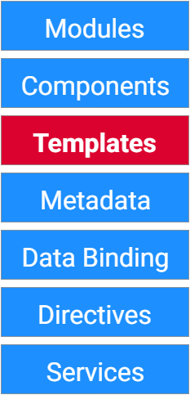
Building Blocks
A Component view is defined by its associated
Template,
A Template is bunch of HTML tags,
Along side with the HTML, a Template typically contains some particular expressions and syntax which belong to Angular,
A Template may contain some Custom Tags, that represent another Component, the selectors.

Slide 45
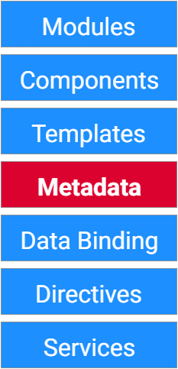
Building Blocks
A Module, a Component, a Directive or a Service are just TypeScript Classes until we tell Angular about the difference between them, and that is done by the Metadata,
We attach Metadata in TypeScript to a class by using Decorators, @NgModule, @Component, @Injectable…
Metadata tells Angular which Template belongs to which Component and which Component belongs to which Module…
Class + @Component + Metadata = A Component

Slide 46
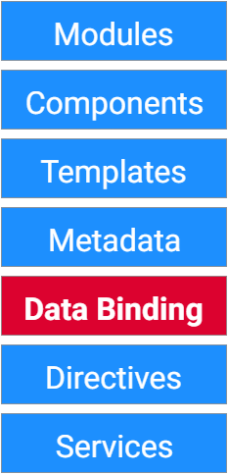
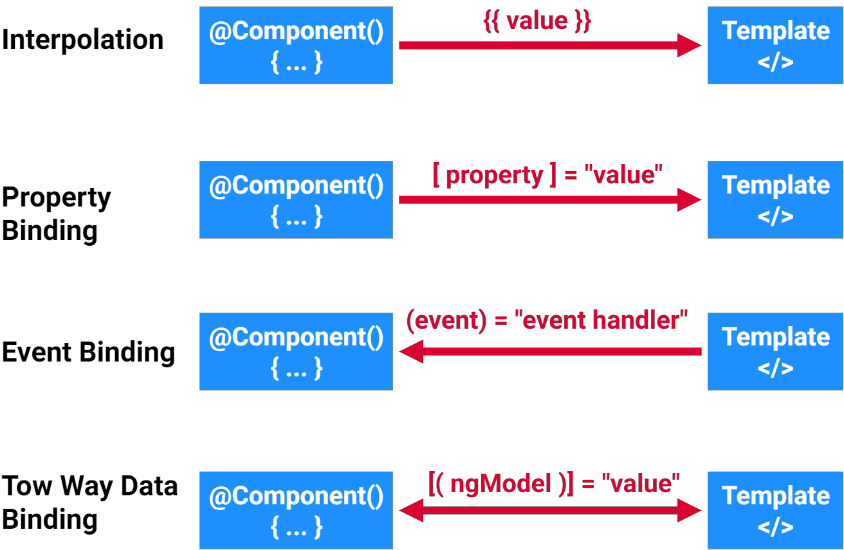
Building Blocks

Slide 47
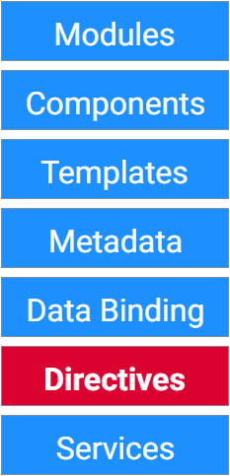
Building Blocks
A Directive is a TypeScript class with the Decorator
@Directive,
Directives appear within HTML tag as attributes, Two kind of directives: Structural & Attribute
Directives,
Structural Directives change the layout by adding or removing Template elements,
Example: *ngFor & *ngIf.
Attribute Directives change the appearance or the behavior of an existing Template element, Example: ngModel, ngStyle & ngClass.

Slide 48
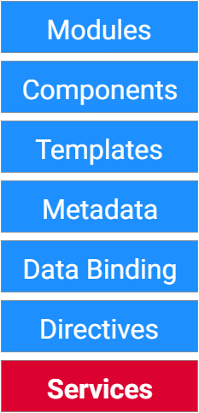
Building Blocks
A Service is a TypeScript class with the Decorator
@Injectable,
A Service achieve some functionalities for the application such us fetching data from server, authentication…
This kind of functionalities should not be done in the Component,
A Component should only take care of rendering the Template (view).

Slide 49





Components
Components are a logical piece of code for Angular application.
A Component consists of the following −
 |  |  | Component
Template |  |  | Class |  |  | Metadata
Template is used to render the view for the application.
This contains the HTML that
needs to be rendered in the application.
This is like a class defined in any language such as C#.
This has the code which is used to support the view.
It is defined in TypeScript.
This has the extra data defined for the Angular class.
It is defined with a decorator.

Slide 50
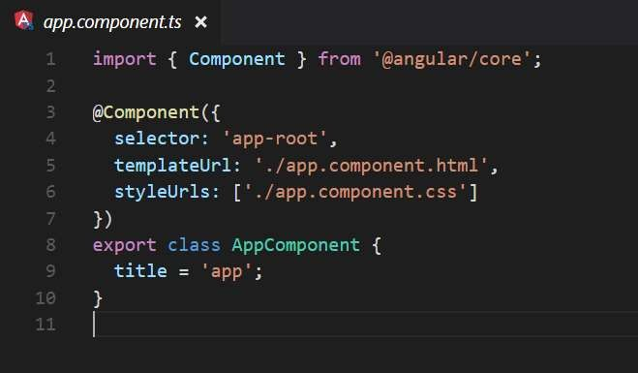
We are using the import keyword to import the ‘Component’ decorator from the angular/core module.
Decorator
Defines the name of the HTML tag.
It holds our HTML template.
The styles option is used to style a specific component
Defining a class called AppComponent.
The export keyword is used so that the component can be used in other modules in the application.
title is the name of the property.
The property is given a value of ‘app’.

Slide 51

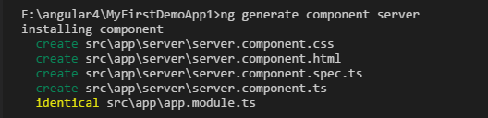
Creating Component
ng generate command is used for create component.
Example F:/Angular4/MyFirstDemoApp> ng g c server
Syntax
ng generate component <component_name>
or
ng g c <component_name>

Slide 52

Component Selector
By Element
Define by square brackets [ ] in selector name.
Syntax
@Component({
selector: '[selector-name]', templateUrl: ‘html - template',
styleUrls: [‘stylesheet']
})
Example
@Component({ selector: '[app-root]',
templateUrl: './app.component.html', styleUrls: ['./app.component.css']
})
<div selector_name> </div>
<div app-root> </div>

Slide 53
Define by dot ( . ) in selector name.
By Class
Syntax
@Component({
selector: ‘.selector-name',
templateUrl: ‘html - template', styleUrls: [‘stylesheet']
})
Example
@Component({ selector: ‘.app-root',
templateUrl: './app.component.html', styleUrls: ['./app.component.css']
})
<div class =“selector-name”>
<div class=“app-root”> </div>

Slide 54

Data binding
Data binding is communication between business logic and views.
Data binding = Communication
Typescript Code
(Business Logic)
Output Data
Template (HTML)
String Interpolation => {{ data }}
Property Binding => [property] = “ data “

Slide 55
String Interpolation
Interpolation markup is used to provide data-binding to text and attribute values.
Syntax
export class <class_name>
{
variableName = ‘any string';
}
Example
export class AppComponent
{
title = ‘This is my demo app';
}
<div {{variableName }} >
<div {{ title }} > </div>

Slide 56
Property Binding
Property binding allow us to bind values to properties of an element to modify their behavior or appearance. This can include properties such as class, disabled, href or textContent.
HTML
<button [disabled]="!isActive" class="btn">ADD</button>
Typescript
export class ClientComponent { isActive = false;
constructor() {
setTimeout(() =>
{ this.isActive = true; }, 2000); } ngOnInit() { }

